Slide 1
Simulating Physics with Quantum Computers
Quantum is Better!!
SungBin Lee, Gyunghun Kim, Kihyeon Kim, Hosung Lee, Dohwon Lee

Slide 2
Contents
Introduction
Classical Computation
Quantum Circuit
Local Magnetization
N half
Correlation Function
Discussion

Slide 3
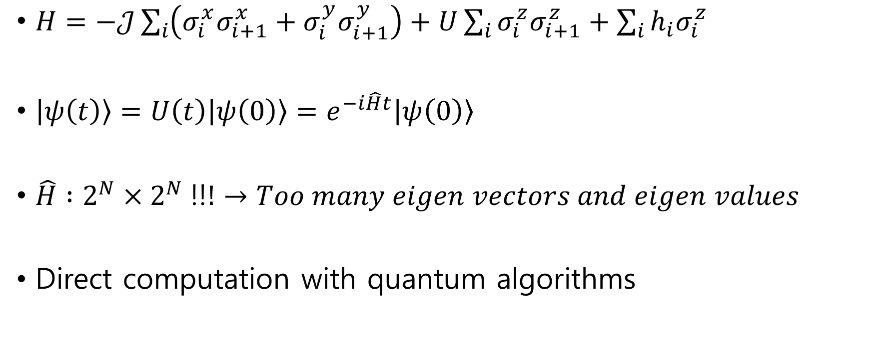
Introduction
$H=−𝒥\sum_{i}{\left(σ_{i}^{x}σ_{i+1}^{x}+σ_{i}^{y}σ_{i+1}^{y}\right)}+U\sum_{i}{σ_{i}^{z}σ_{i+1}^{z}}+\sum_{i}{h_{i}σ_{i}^{z}}$
$\left|ψ\left(t\right)\right\rangle =U\left(t\right)\left|ψ\left(0\right)\right\rangle =e^{−i\hat{H}t}\left|ψ\left(0\right)\right\rangle$
$\hat{H} :2^{N}×2^{N} ‼!→Too many eigen vectors and eigen values$
Direct computation with quantum algorithms

Slide 4
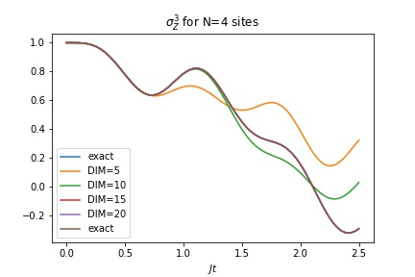
Classical Computation
Lanczos Algorithm
DIM = 50
A huge

Slide 5
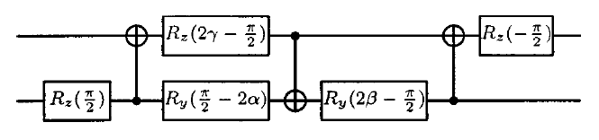
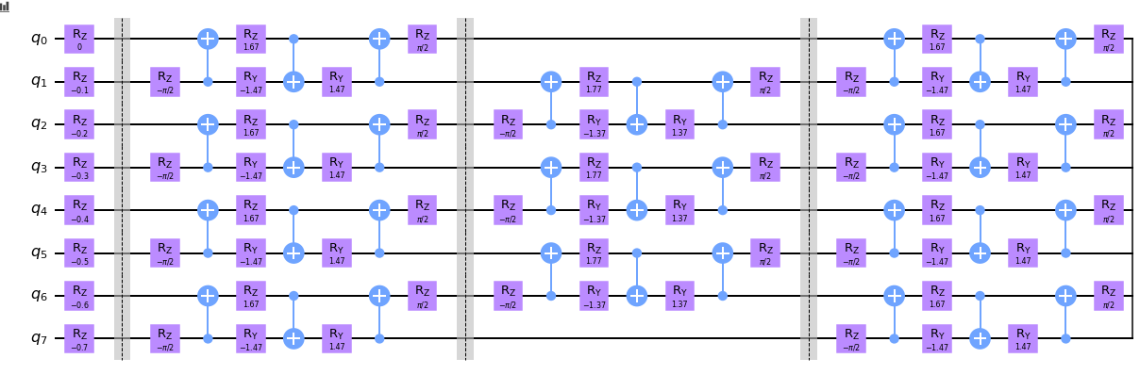
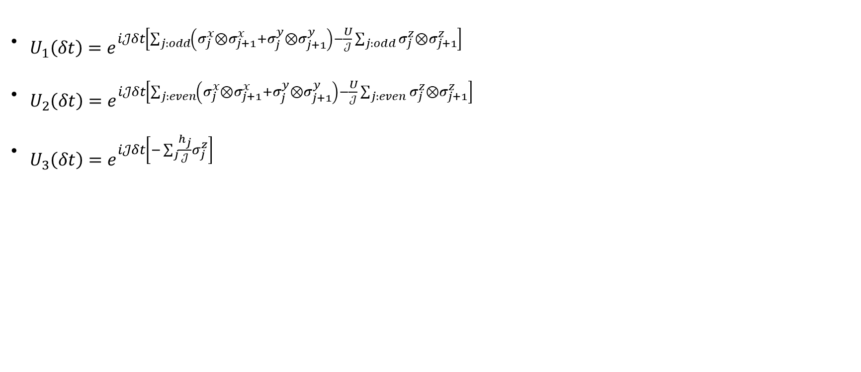
Quantum Circuit
$\begin{aligned}U_{1}\left(δt\right)=e^{i𝒥δt\left[\sum_{j:odd}{\left(σ_{j}^{x}⊗σ_{j+1}^{x}+σ_{j}^{y}⊗σ_{j+1}^{y}\right)}−\frac{U}{𝒥}\sum_{j:odd}{σ_{j}^{z}⊗σ_{j+1}^{z}}\right]}\#\end{aligned}$
$\begin{aligned}U_{2}\left(δt\right)=e^{i𝒥δt\left[\sum_{j:even}{\left(σ_{j}^{x}⊗σ_{j+1}^{x}+σ_{j}^{y}⊗σ_{j+1}^{y}\right)}−\frac{U}{𝒥}\sum_{j:even}{σ_{j}^{z}⊗σ_{j+1}^{z}}\right]}\end{aligned}$
$\begin{aligned}U_{3}\left(δt\right)=e^{i𝒥δt\left[−\sum_{j}{\frac{h_{j}}{𝒥}}σ_{j}^{z}\right]}\#\end{aligned}$

Slide 6
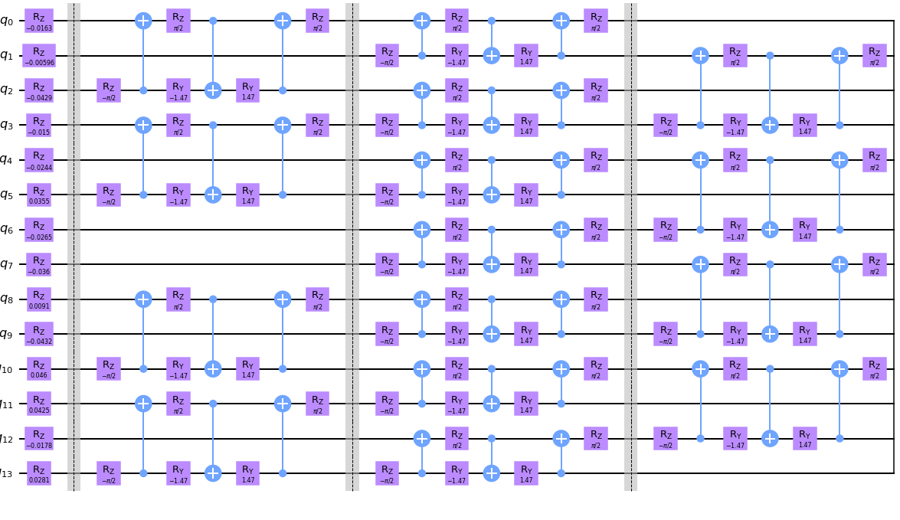
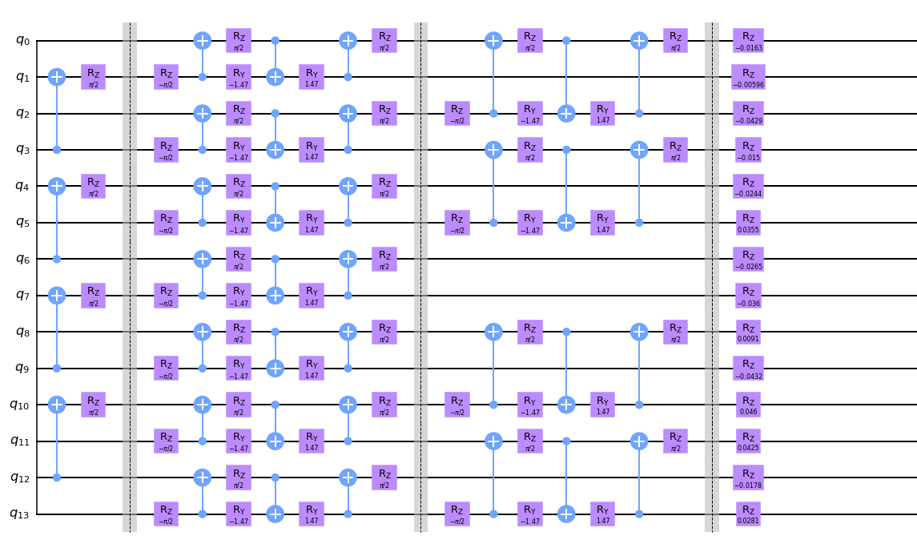
Quantum Circuit

Slide 7
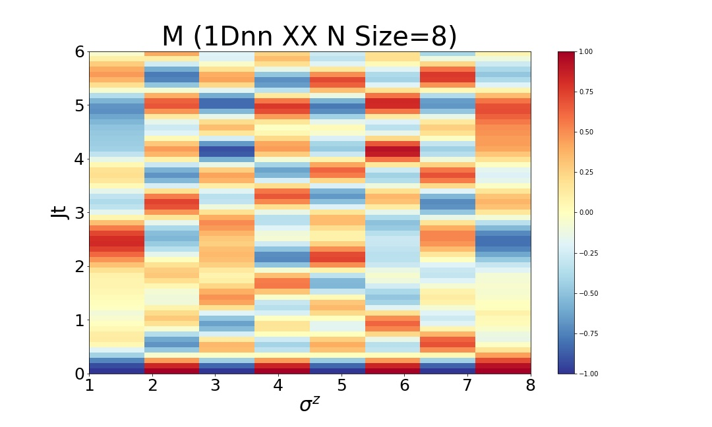
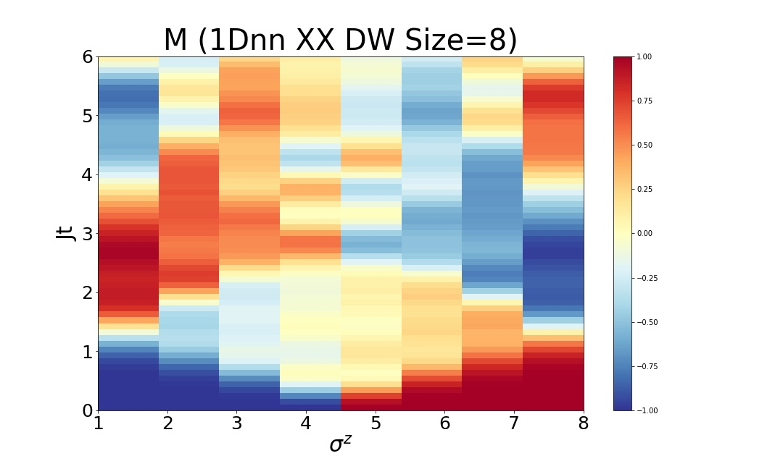
Local Magnetization

Slide 8
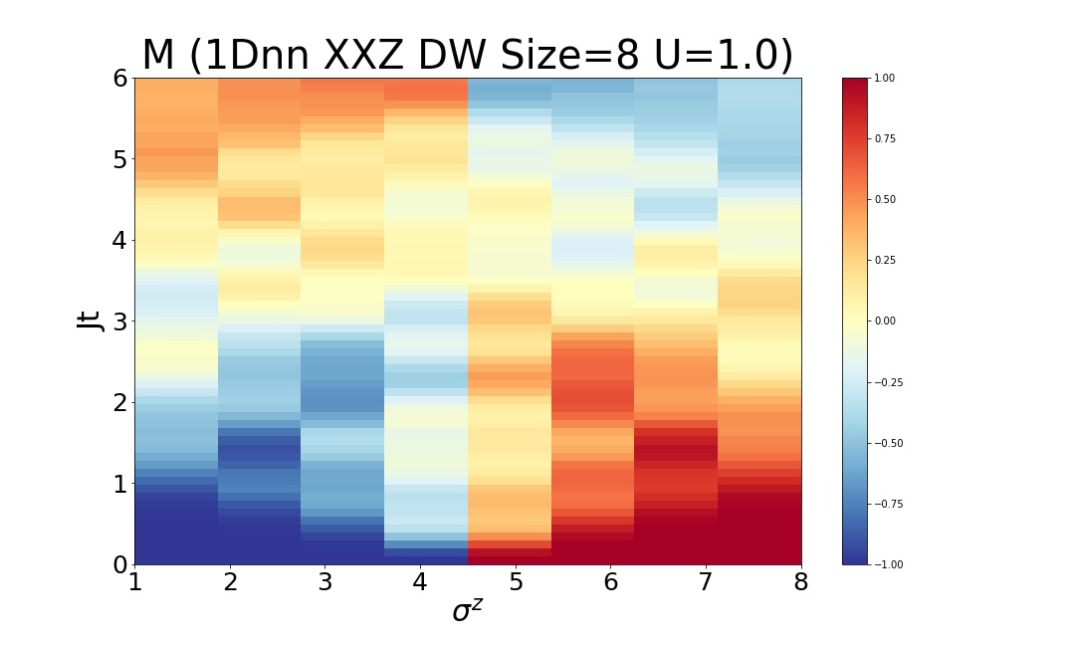
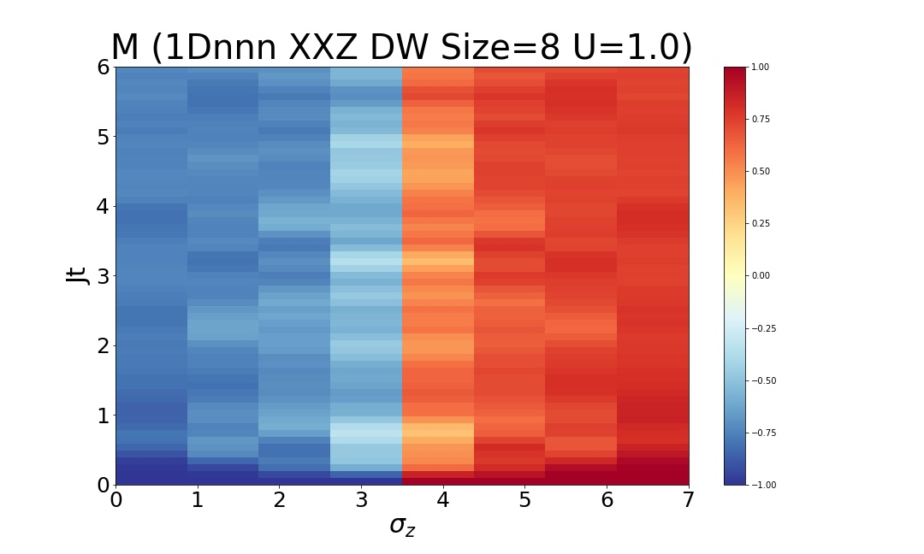
Local Magnetization

Slide 9
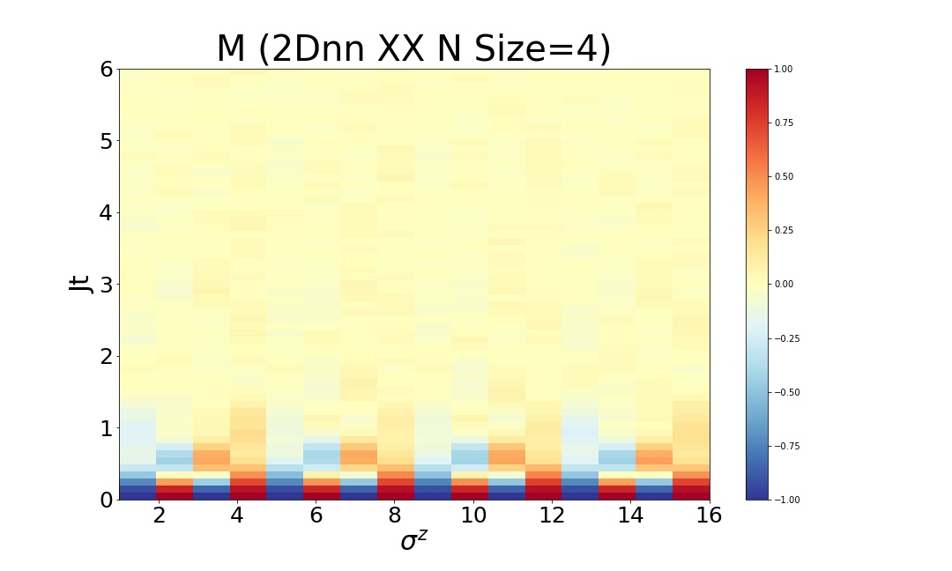
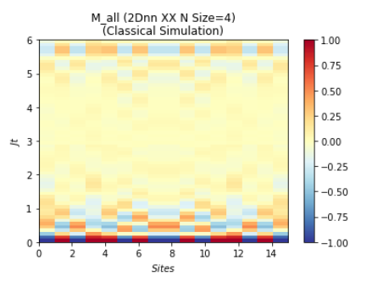
Local Magnetization

Slide 10
Local Magnetization

Slide 11
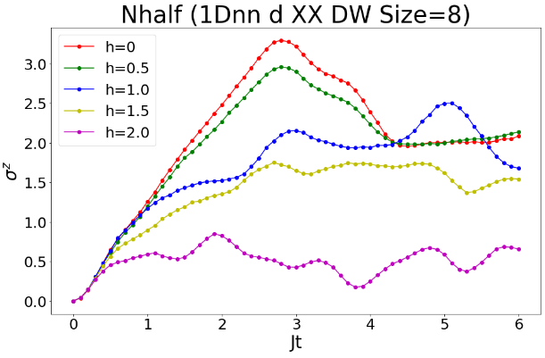
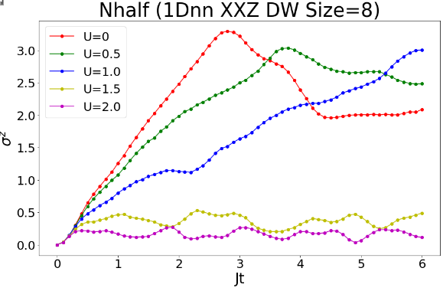
Nhalf

Slide 12

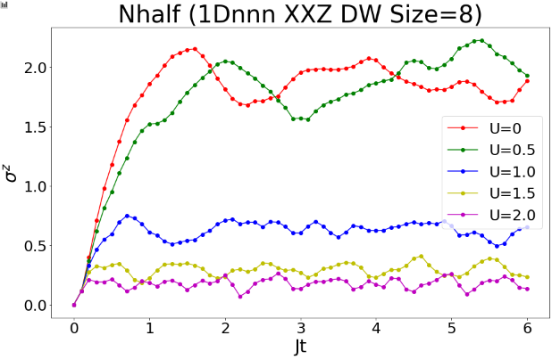
Nhalf

Slide 13
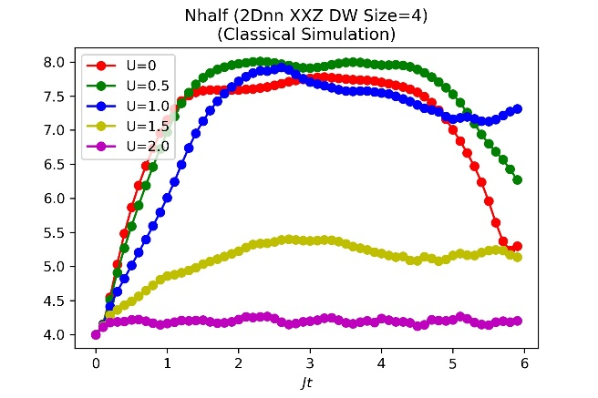
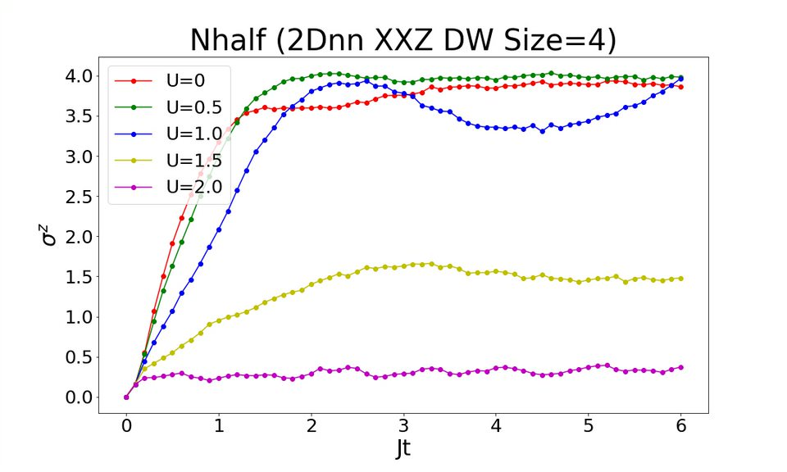
Nhalf

Slide 14
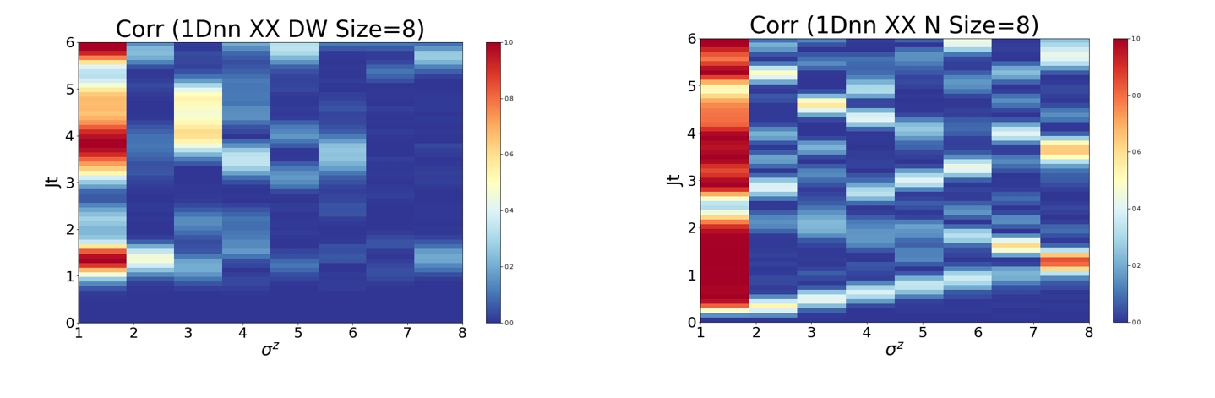
Correlation Function

Slide 15
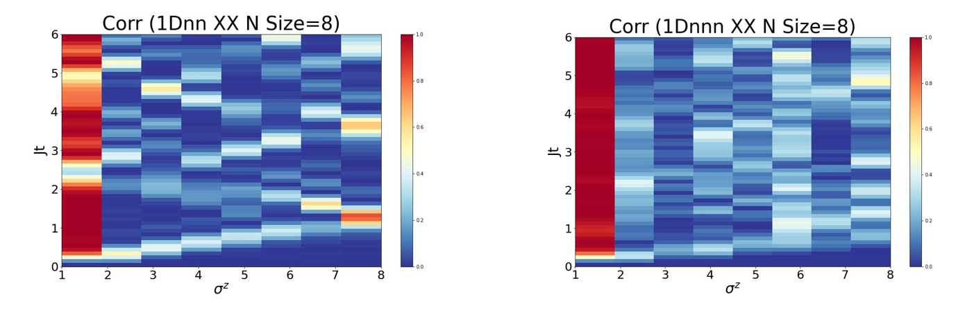
Correlation Function

Slide 16
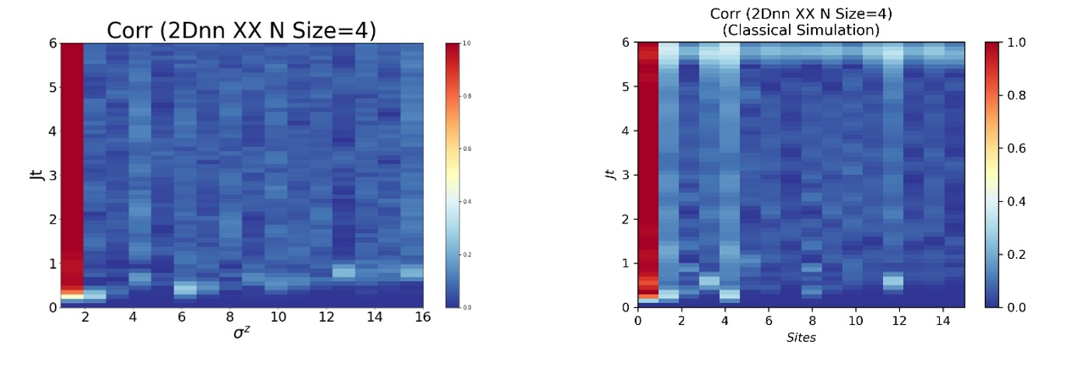
Correlation Fucntion

Slide 17
Correlation Fucntion

Slide 18
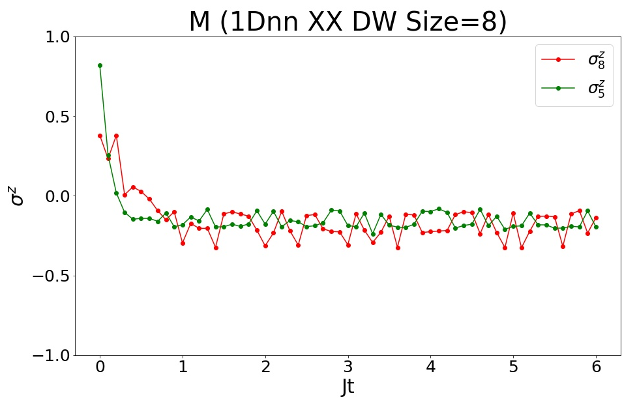
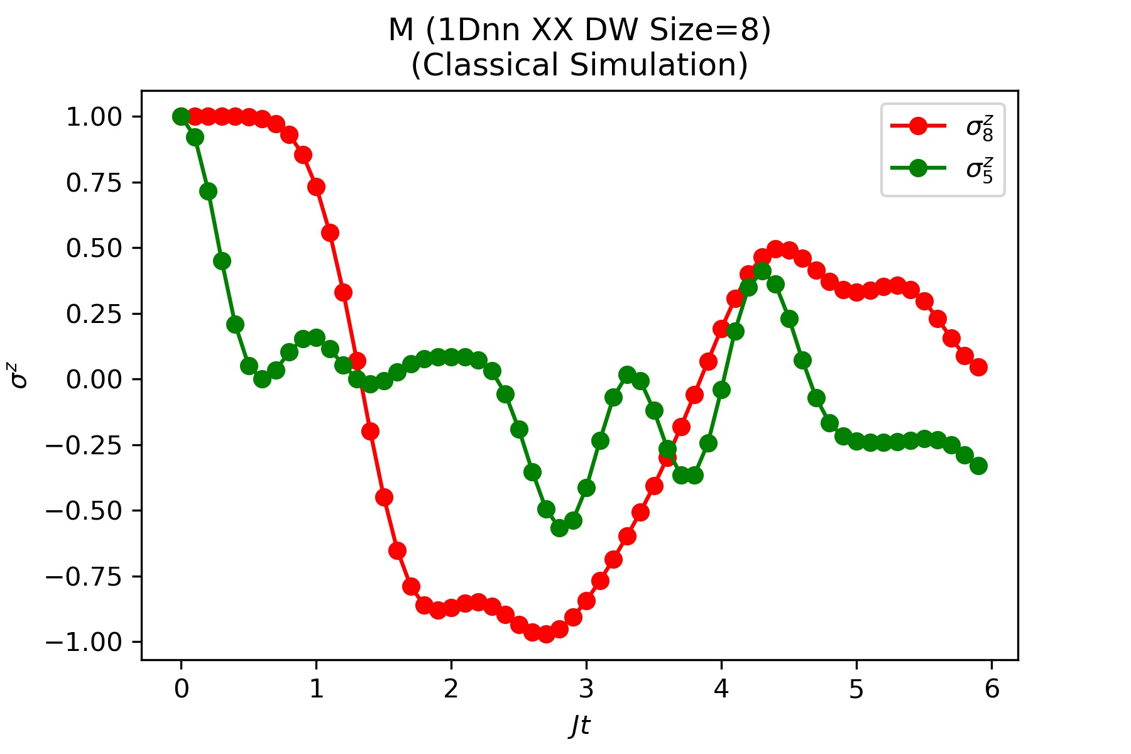
Limitations of Noisy Quantum Backend

Slide 19
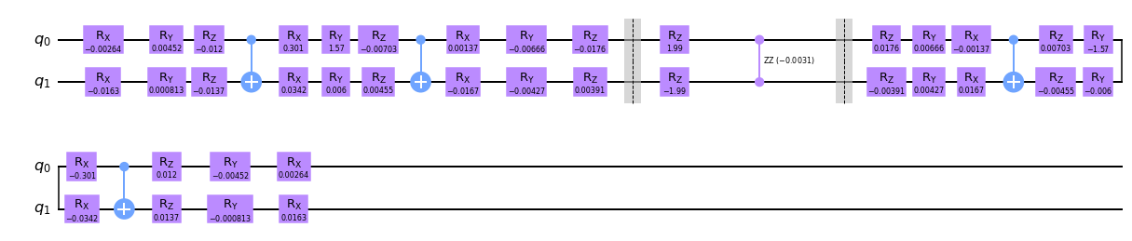
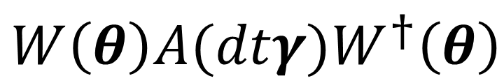
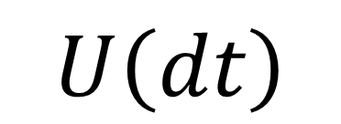
Solution: Variational Fast Forwarding
$$U\left(dt\right)$$
$$W\left(θ\right)A(dtγ)W^{†}\left(θ\right)$$

Slide 20
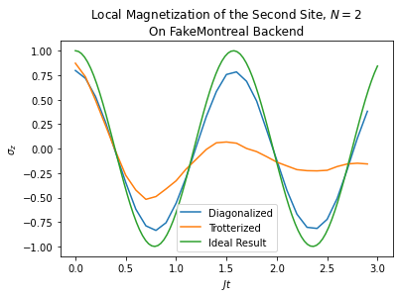
Simulation of the Diagonalized Circuit

Slide 21
References
[1] https://www.tensors.net/exact-diagonalization, Retrieved on July 1, 2021.
[2] Phillip Weinberg, Marin Bukov. QuSpin: a Python Package for Dynamics and Exact Diagonalisation of Quantum Many Body Systems part I: spin chains. (2016). arXiv:1610.03042 [physics.comp-ph]
[3] Vatan, F. & Williams, C. Optimal quantum circuits for general two-qubit gates. Phys. Rev. A 69, 032315 (2004).
[4] Smith, A., Kim, M. S., Pollmann, F., & Knolle, J. (2019). Simulating quantum many-body dynamics on a current digital quantum computer. npj Quantum Information, 5(1), 1-13.
[5] Cîrstoiu, C., Holmes, Z., Iosue, J. et al. Variational fast forwarding for quantum simulation beyond the coherence time. npj Quantum Inf 6, 82 (2020). https://doi.org/10.1038/s41534-020-00302-0
[6] Geller, Michael & Holmes, Zoe & Coles, Patrick & Sornborger, Andrew. Experimental Quantum Learning of a Spectral Decomposition. (2021).

